Slide 1
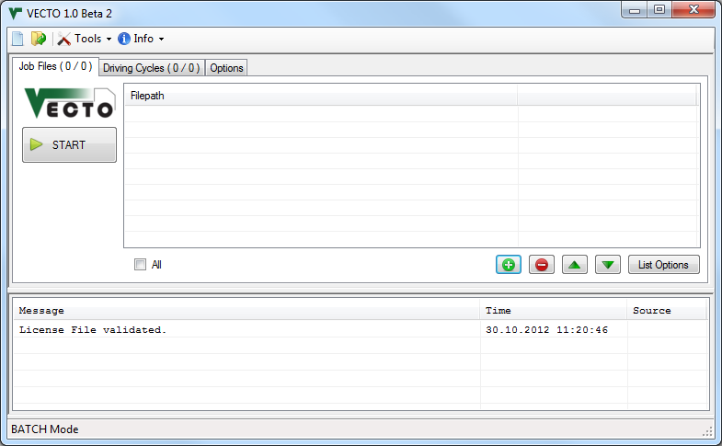

Slide 2
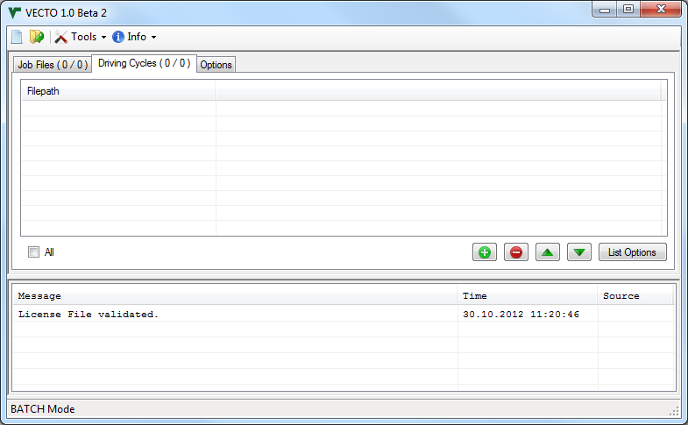

Slide 3
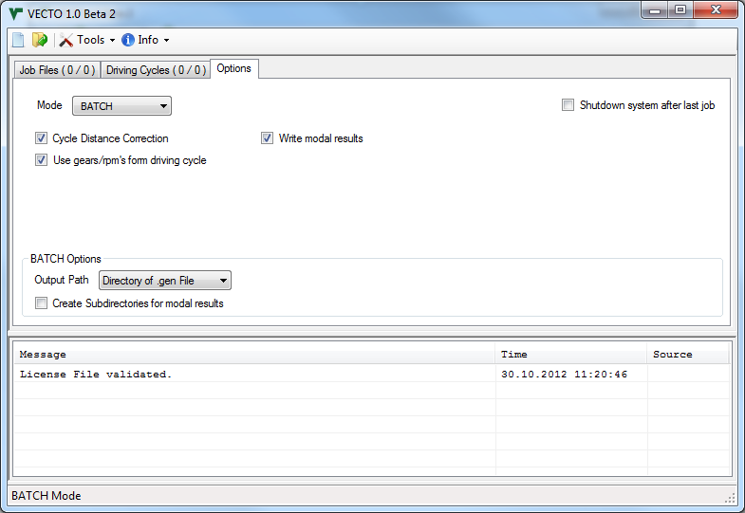

Slide 4
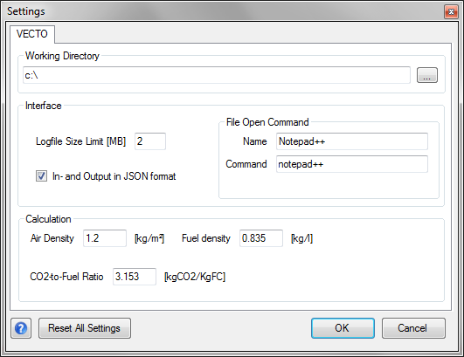

Slide 5
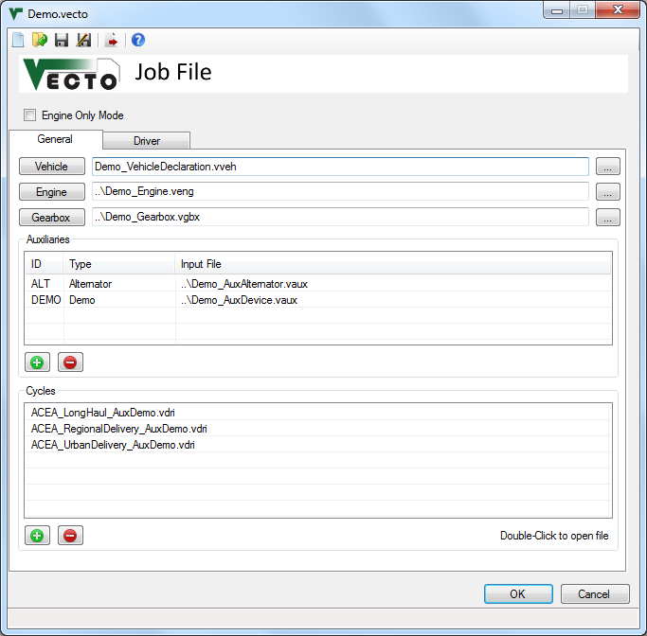

Slide 6
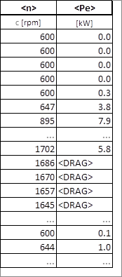
Engine motoring operation. Can also be used with <Me>

Slide 7
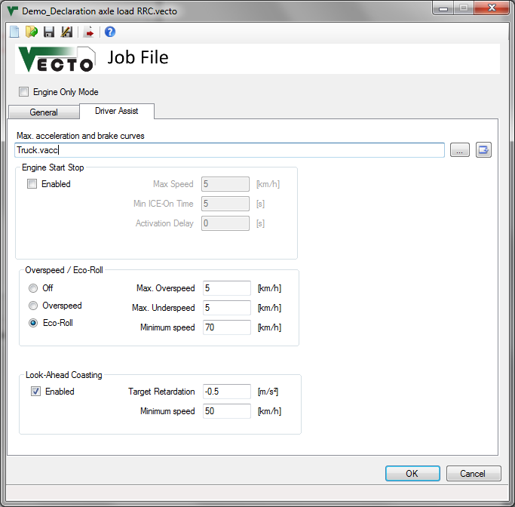

Slide 8
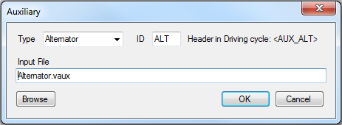
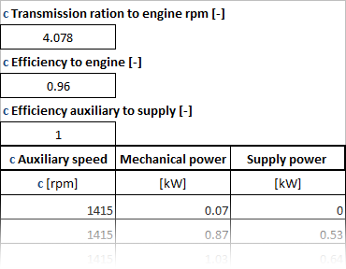

Slide 9
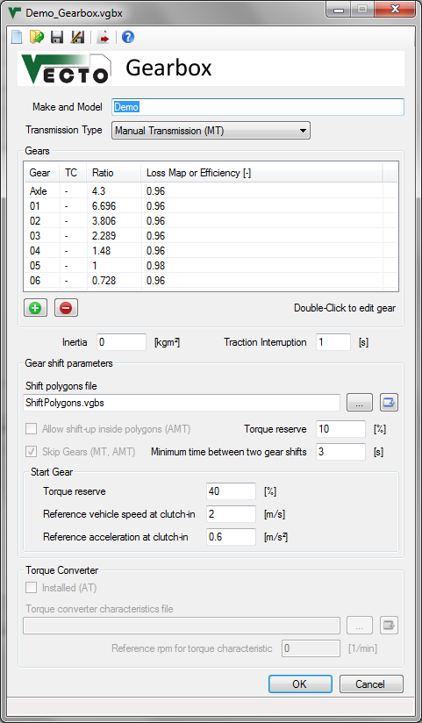
$$Output Torque=\left(Input Torque−Torque Loss\right)×GearRatio$$

Slide 10
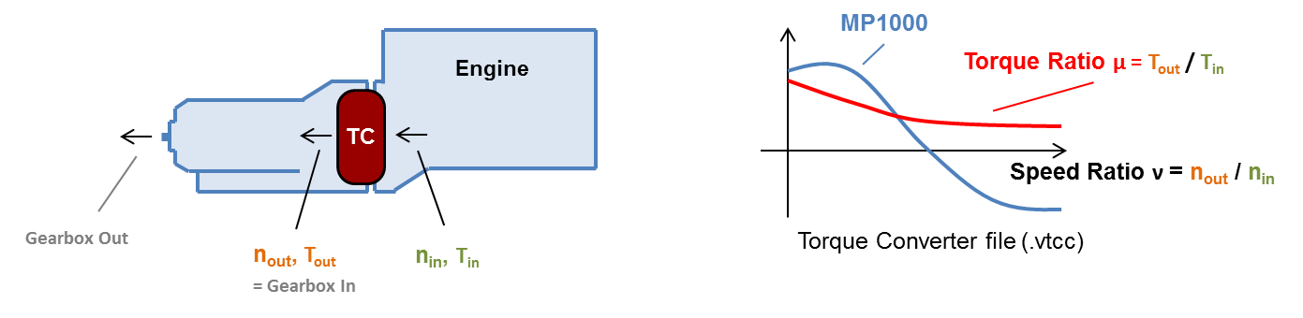
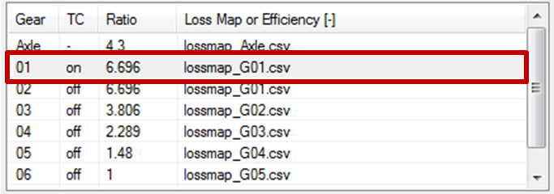
Original in Update Notes.pptx

Slide 11
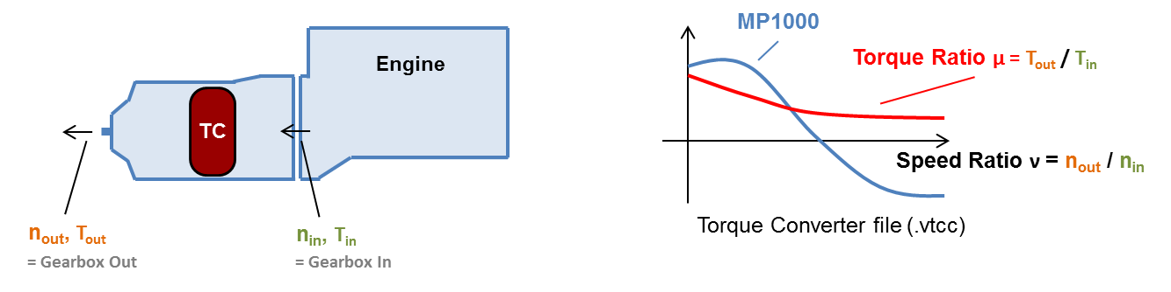
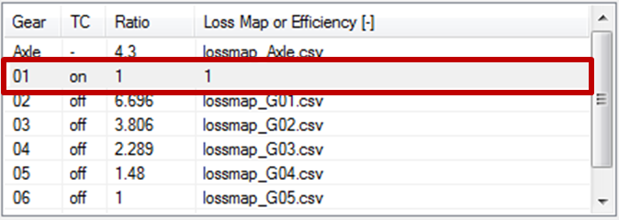
Original in Update Notes.pptx

Slide 12
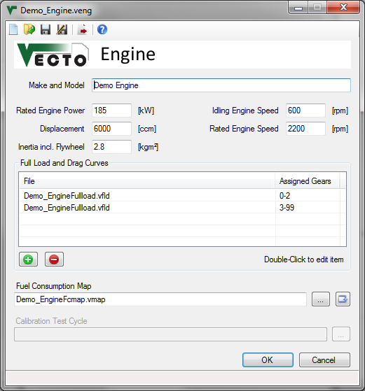

Slide 13
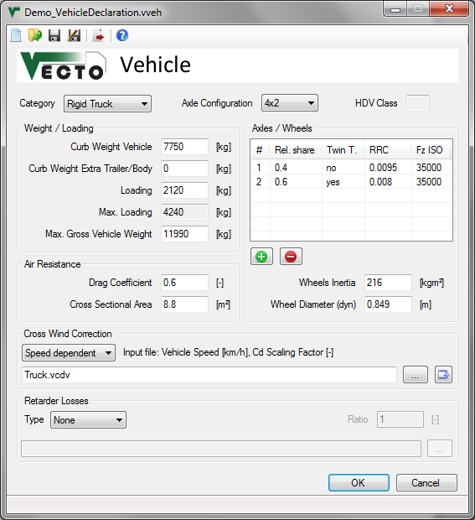
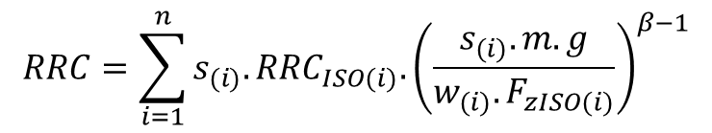
$$RRC=\sum_{i=1}^{n}{{s_{(i)}.RRC}_{ISO(i)}.{\left(\frac{s_{(i)}.m.g}{{w_{(i)}.F}_{zISO(i)}}\right)}^{β−1}}$$

Slide 14
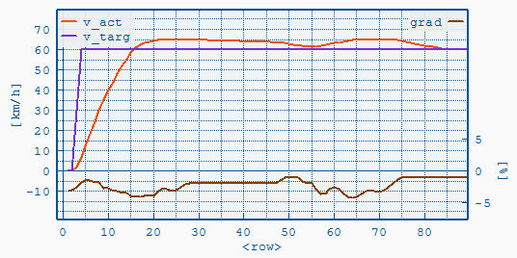
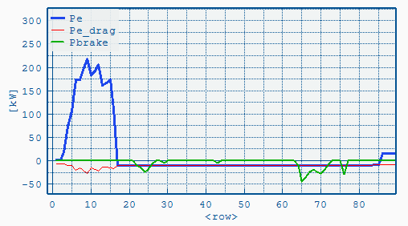
Coasting with Brakes applied if Overspeed is reached

Slide 15
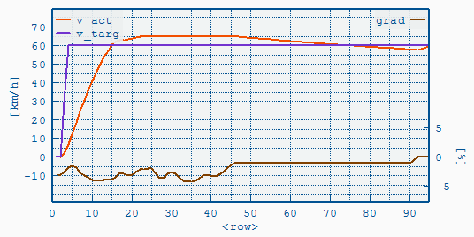
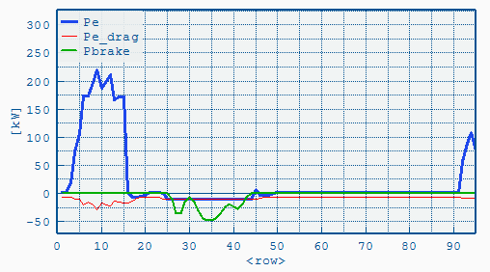
Overspeed reached:
Coasting & Braking
Engine idling

Slide 16
T = (vset₁-vset₂) / a_{lookahead} e.g. a_{lookahead} = -0.5m/s²
V
Vset₁
Deceleration according to a_{brake}=f(v)-curve e.g. = -1m/s²
coasting phase
resulting vehicle speed course
Vset₂
time

Slide 17
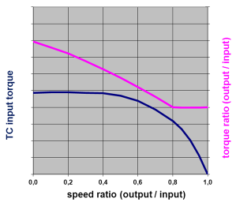
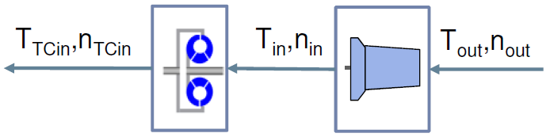
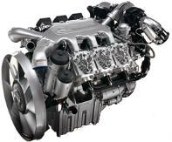
Torque converter characteristic (.vtcc file)
Quasi stationary backwards calculation
Transmission losses added
Longitudinal dynamics
Iteration
Engine
Torque converter
Transmission

Slide 18
.vaux file
.vdri file
TransRatio
EffToEng
EffToSply
AuxMap(n,Pe)
Psupply

Slide 19
1) n_{Aux} = n_{Eng} * TransRatio
with: n_{Eng} = engine speed
2) P_{AuxOut} = Psupply / EffToSply
3) P_{AuxIn} = AuxMap(n_{Aux}, P_{AuxOut})
4) P_{AuxDemand} = P_{AuxIn} / EffToEng
P_{AuxDemand} is directly added to the engine's power demand

